Slide 1
MRI Homework3
報告者：王韵雯
日期：2015/12/1

Slide 2
Outline
Software
Equation
Python
Matlab

Slide 3
Software
spyder-app 2.3.7
MATLAB R2012a

Slide 4

Equation
$M\left(t\right)= X_{0}×(1−e^{−x/{T_{1}}})$
$M\left(t\right)= X_{0}×e^{−x/{T_{2}}}$

Slide 5
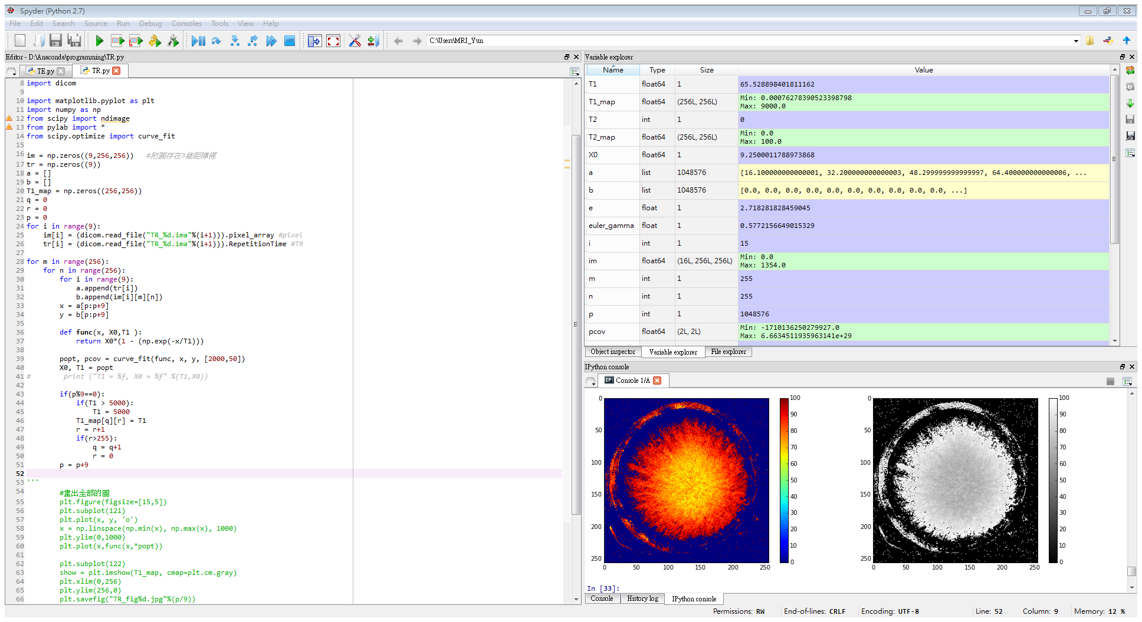
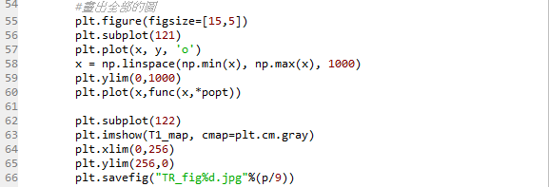
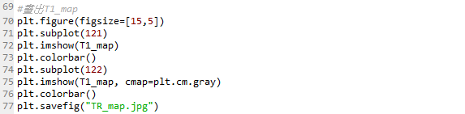
Python code-T1 fitting

Slide 6
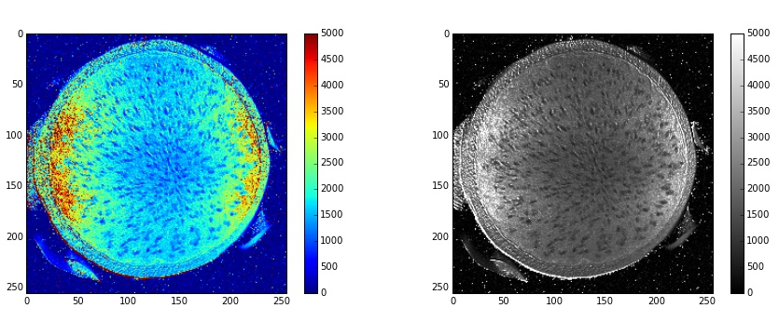
T1 map

Slide 7
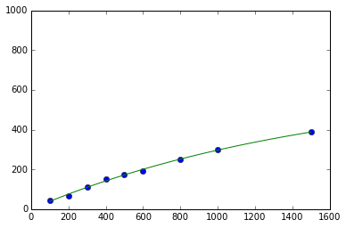
T1 fitting
[128,128]
T1 = 1561.877938, X0 = 628.158365

Slide 8
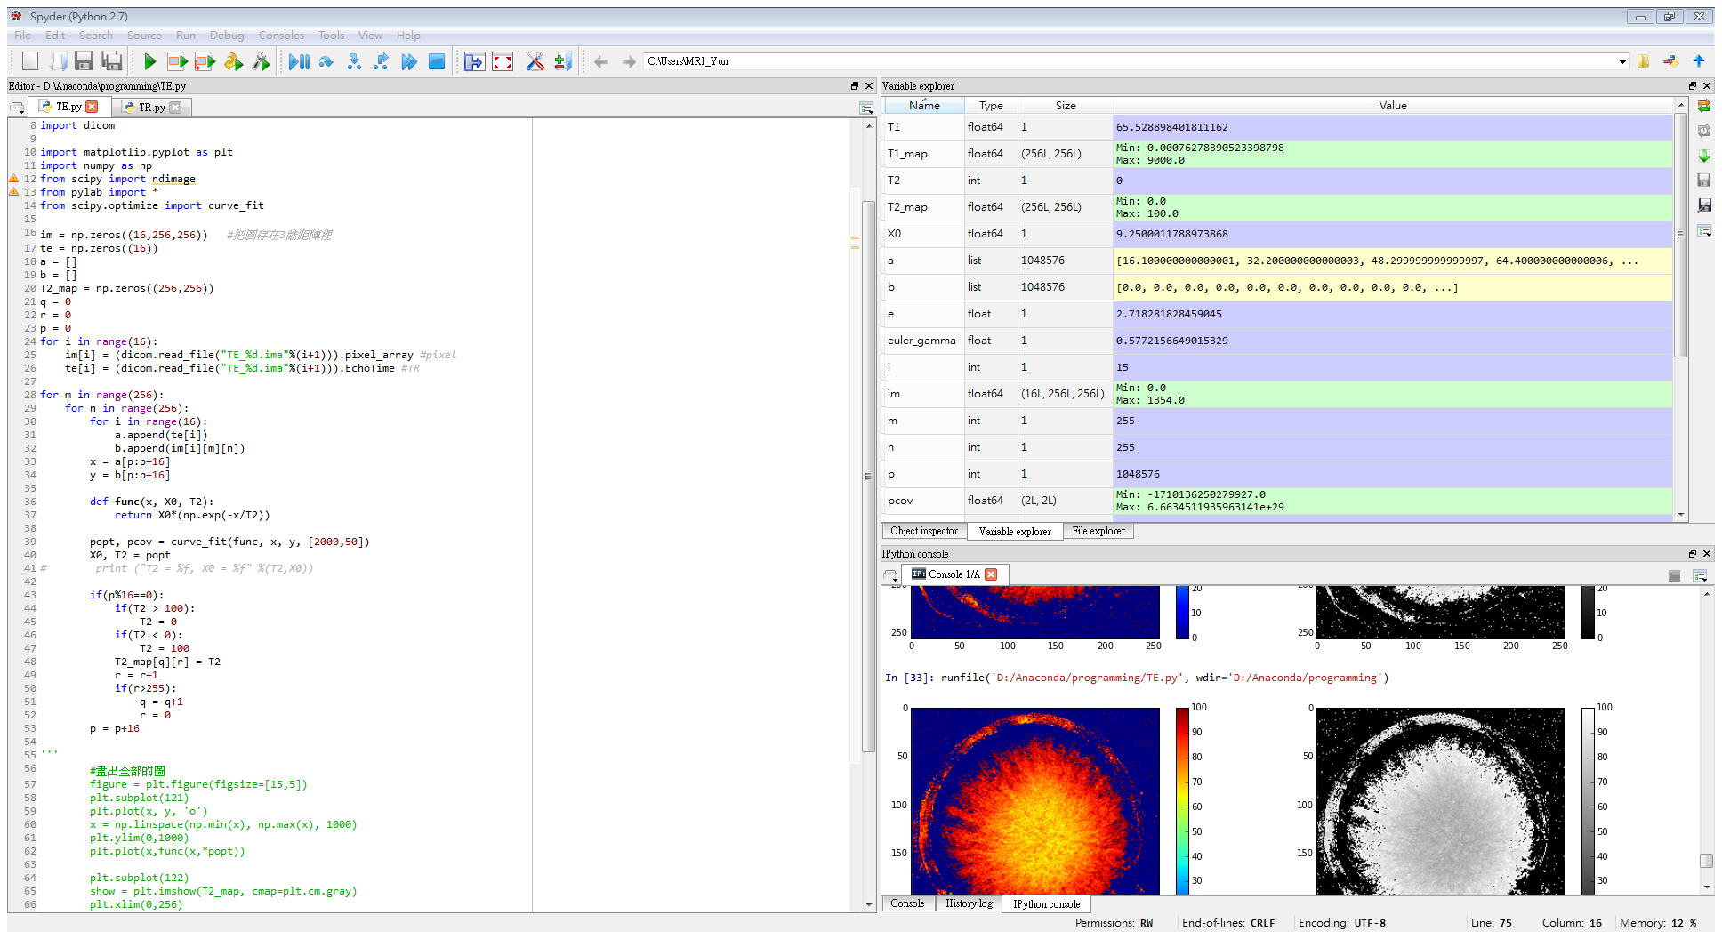
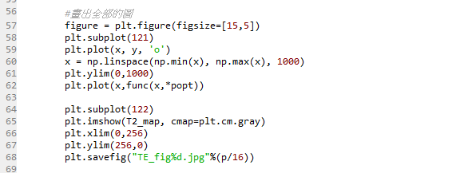
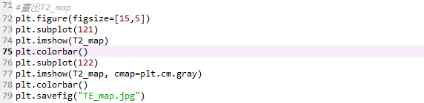
Python code-T2 fitting

Slide 9
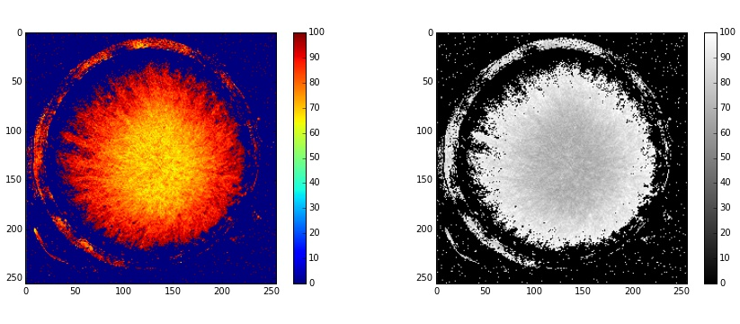
T2 map

Slide 10
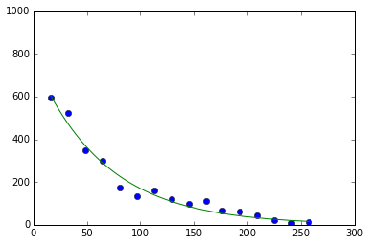
T2 fitting
[128,128]
T2 = 65.873007, X0 = 773.336103

